Slide 1


Quirino Ygot
30th August 2023

Slide 2

Outline
Executive Summary
Introduction
Methodology
Results
Conclusion
Appendix

Slide 3
Executive Summary
Summary of methodologies
- Data Collection through API
- Data Collection with Web Scraping
- Data Wrangling
- Exploratory Data Analysis with SQL
- Exploratory Data Analysis with Data Visualization
- Interactive Visual Analytics with Folium
- Machine Learning Prediction
Summary of all results
- Exploratory Data Analysis result
- Interactive analytics in screenshots
- Predictive Analytics result

Slide 4
Introduction
Project background and context
Space X advertises Falcon 9 rocket launches on its website with a cost of 62 million dollars; other providers cost upward of 165 million dollars each, much of the savings is because Space X can reuse the first stage. Therefore, if we can determine if the first stage will land, we can determine the cost of a launch. This information can be used if an alternate company wants to bid against space X for a rocket launch. This goal of the project is to create a machine learning pipeline to predict if the first stage will land successfully.
Problems you want to find answers
- What factors determine if the rocket will land successfully?
- The interaction amongst various features that determine the success rate of a successful landing.
- What operating conditions needs to be in place to ensure a successful landing program?

Slide 5

Section 1

Slide 6
Methodology
Executive Summary
Data collection methodology:
Data was collected using SpaceX API and web scraping from Wikipedia.
Perform data wrangling
One-hot encoding was applied to categorical features.
Perform exploratory data analysis (EDA) using visualization and SQL
Perform interactive visual analytics using Folium and Plotly Dash
Perform predictive analysis using classification models
How to build, tune, evaluate classification models

Slide 7
Data Collection
Describe how data sets were collected.
- Data collection was done using get request to the SpaceX API.
- Next, I decoded the response content as a Json using .json() function call and turn it
into a pandas dataframe using .json_normalize().
- I then cleaned the data, checked for missing values and fill in missing values where
necessary.
- In addition, I performed web scraping from Wikipedia for Falcon 9 launch records with
BeautifulSoup.
- The objective was to extract the launch records as HTML table, parse the table and
convert it to a pandas dataframe for future analysis.

Slide 8
Data Collection – SpaceX API
I used the get request to the SpaceX API to collect data, clean the requested data and did some basic data wrangling and formatting.
Here is the link to the notebook: IBM-Data-Science-Capstone/Data Collection API.ipynb at main · kerygot16/IBM-Data-Science-Capstone (github.com)
Get request for rocket launch data using API
Use json_normalize method to convert json result to dataframe
Perform data cleaning and filling in the missing values

Slide 9
Data Collection - Scraping
Apply HTTP get method to request the Falcon 9 rocket launch page
Create Beautiful Soup object from the HTML Response
Extract all column names from the HTML table header
Create dataframe by parsing the launch HTML tables
Export data to CSV
I applied web scraping to webscrap Falcon 9 launch records with Beautiful Soup
I parsed the table and converted it into a pandas dataframe
Here is the link to the notebook: IBM-Data-Science-Capstone/Data Collection With Webscraping.ipynb at main · kerygot16/IBM-Data-Science-Capstone (github.com)

Slide 10
Data Wrangling
I calculate the number and occurrence of each orbit
Then I calculate the number and occurrence of mission outcome per orbit type
I calculate the number of launches on each site
I finally create a landing outcome label from Outcome column
I performed some Exploratory Data Analysis (EDA) to find some patters in the data and determine what would be the label for training supervised models.
I convert the outcomes into Training labels with 1 if the booster successfully landed and 0 if it was unsuccessful.
Here is the link of the notebook: IBM-Data-Science-Capstone/Data Wrangling.ipynb at main · kerygot16/IBM-Data-Science-Capstone (github.com)

Slide 11
EDA with Data Visualization
Using scatter plot, I plot out the Flight Number and Payload Mass Variables to see how would they affect the launch outcome
I then used scatter plot to visualize the relationship between Flight Number and Launch Site as well as the relationship between Flight Number and Launch Site.
To visualize the relationship between success rate of each orbit type, I used the bar chart
I also used the scatter point chart to visualize the relationship between Flight Number and Orbit Type and Payload with respect to the Orbit Type.
I then visualize the launch success yearly trend using the line chart.
Here is the github link for my completed EDA with data visualization notebook: IBM-Data-Science-Capstone/EDA with Data Visualization.ipynb at main · kerygot16/IBM-Data-Science-Capstone (github.com)

Slide 12
EDA with SQL
I loaded the SpaceX dataset into a PostgreSQL database without leaving the jupyter notebook.
I then applied EDA with SQL to get any insights from the data. I wrote queries to find out relevant information such as:
- The names of unique launch sites in the space mission.
- The total payload mass carried by booster version F9 v1.1
- The total number of successful and failure mission outcomes.
- The failed landing outcomes in drone ship, their booster version and launch site names.
Here is the link to the notebook on EDA with SQL: IBM-Data-Science-Capstone/EDA with SQL.ipynb at main · kerygot16/IBM-Data-Science-Capstone (github.com)

Slide 13
Build an Interactive Map with Folium
Summarize what map objects such as markers, circles, lines, etc. you created and added to a folium map
I marked all launch sites, and added map objects such as markers, circles, lines to mark the success or failure of launches for each site on the folium map.
I then assigned the feature launch outcomes (failure or success) to class 0 and 1, such that 0 for failure and 1 for success.
Using the color-labeled marker clusters, I identified which launch sites have relatively high success rate.
I calculated the distance between a launch site to its proximities and answered some questions such as:
Are launch sites near railways, highways and coastlines?
Do launch sites keep certain distance away from cities?
Please refer to the link for the complete notebook: IBM-Data-Science-Capstone/Interactive Visual Analytics with Folium.ipynb at main · kerygot16/IBM-Data-Science-Capstone (github.com)

Slide 14
Build a Dashboard with Plotly Dash
I plotted pie chart in the dashboard showing the total launches by a certain site.
I used scatter plot to visually observe how payload may be correlated with mission outcomes for selected site(s).
Here is the link for the notebook: IBM-Data-Science-Capstone/spacex_dash_app.py at main · kerygot16/IBM-Data-Science-Capstone (github.com)

Slide 15
Predictive Analysis (Classification)
I loaded the data using numpy and pandas, transformed the data, split into training and testing.
I built different machine learning models such as KNeighbors, Decision Tree, Logistic Regression and Support Vector. And then I tune different hyper parameters using GridSearch CV
I used accuracy as the metric for our model, improved the model using feature engineering and algorithm tubing.
And finally, I found the best performing classification model which is the Decision Tree with 87% score.
Here is the link of the notebook: IBM-Data-Science-Capstone/Machine Learning Prediction.ipynb at main · kerygot16/IBM-Data-Science-Capstone (github.com)

Slide 16
Results
Exploratory data analysis results
Interactive analytics demo in screenshots
Predictive analysis results

Slide 17

Section 2

Slide 18
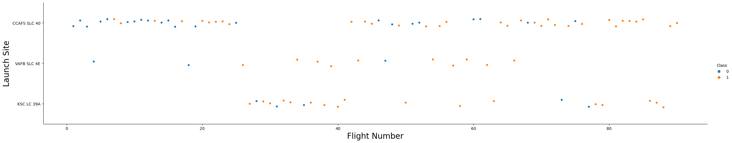
Flight Number vs. Launch Site
From the plot above, we can infer that the larger the flight amount at a launch site, the greater the success rate at a launch site.

Slide 19
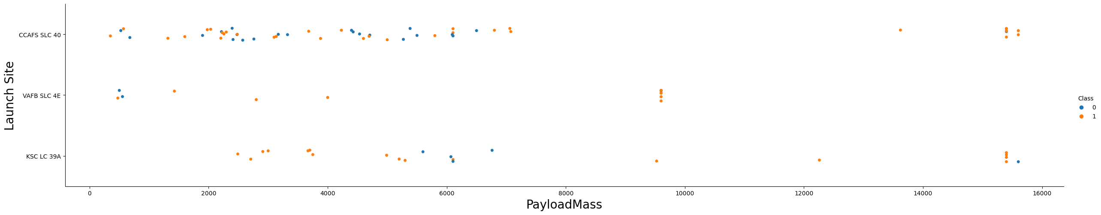
Payload vs. Launch Site
The greater the payload mass for launch site CCAFS SLC 40 the higher the success rate for the rocket.

Slide 20

Success Rate vs. Orbit Type
From the plot, we can see that ES-L 1, GEO, HEO, SSO and VLEO had the most success rate.

Slide 21
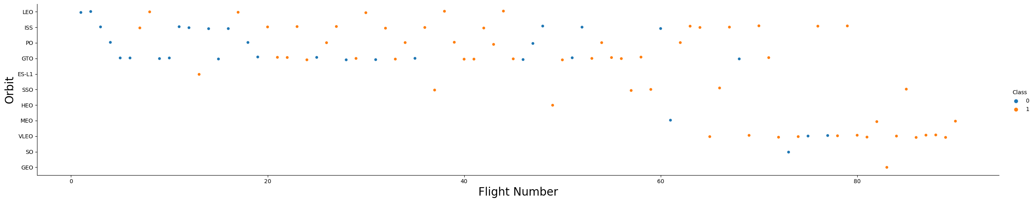
Flight Number vs. Orbit Type
The plot above shows the Flight Number vs. Orbit type. We observe that in the LEO orbit, success is related to the number of flights whereas in the GTO orbit, there is no relationship between flight number and the orbit.

Slide 22
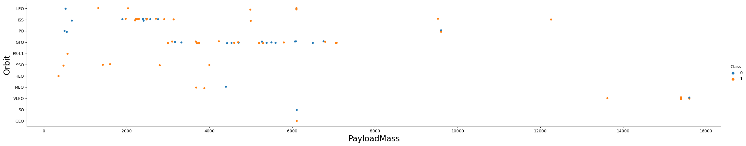
Payload vs. Orbit Type
We can observe that with heavy payloads, the successful landing are more for PO, LEO and ISS orbits.

Slide 23
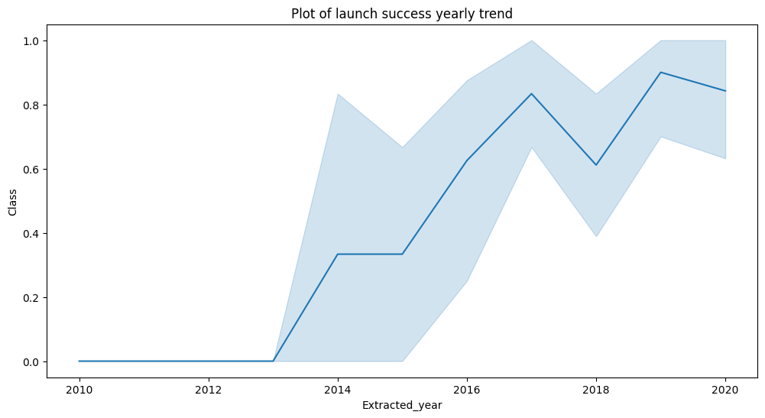
Launch Success Yearly Trend
From the plot, we can observe that success rate since 2013 kept on increasing till 2020.

Slide 24
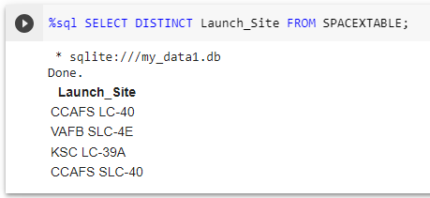
All Launch Site Names
To launch all site names, I used the key word DISTINCT to show only unique launch sites from the SpaceX data.

Slide 25
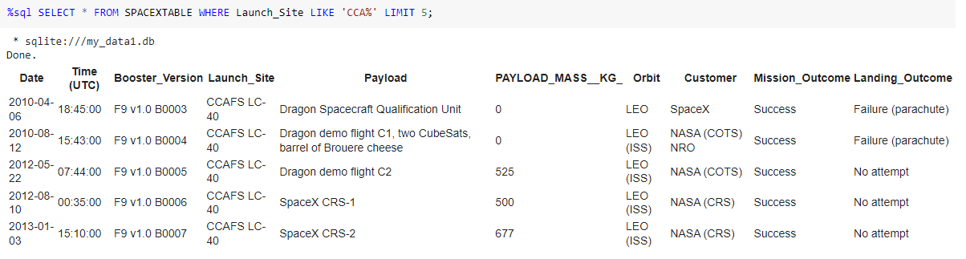
Launch Site Names Begin with 'CCA'
I used the query above to display 5 records where launch sites begin with `CCA`.

Slide 26
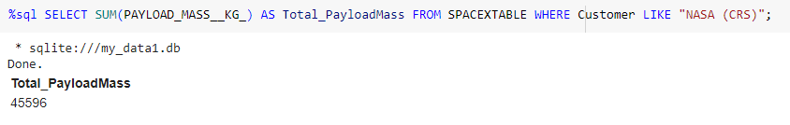
Total Payload Mass
I calculated the total payload carried by boosters from NASA as 45596 using the query below:

Slide 27
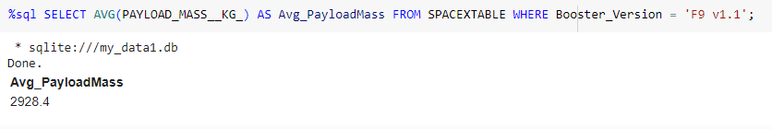
Average Payload Mass by F9 v1.1
I calculated the average payload mass carried by booster version F9 v1.1 as 2928.4

Slide 28
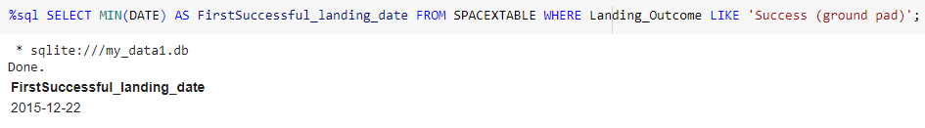
First Successful Ground Landing Date
I observed that the dates of the first successful landing outcome on ground pad was 22nd December 2015.

Slide 29
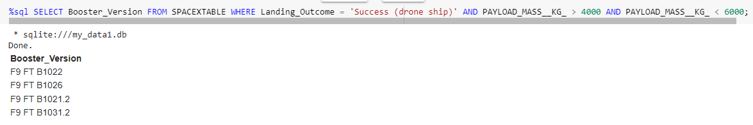
Successful Drone Ship Landing with Payload between 4000 and 6000
I used the WHERE clause to filter for boosters which have successfully landed on drone ship and applied the AND condition to determine successful landing with payload mass greater than 4000 but less than 6000

Slide 30
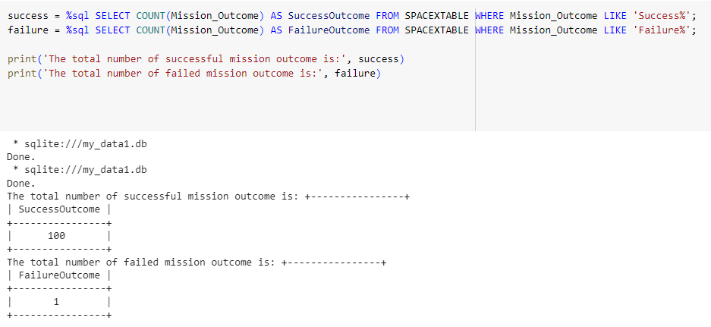
Total Number of Successful and Failure Mission Outcomes
I used wildcard like ‘%’ to filter for WHERE Mission Outcome was a success or a failure.

Slide 31
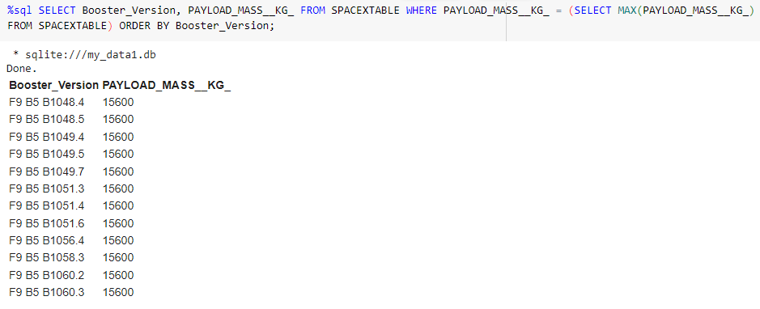
Boosters Carried Maximum Payload
I determined the booster that have carried the maximum payload using a subquery in the WHERE clause and the MAX() function.

Slide 32
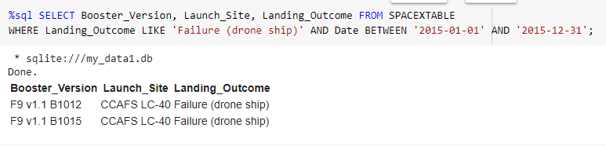
2015 Launch Records
I used a combinations of the WHERE clause, LIKE, AND, and BETWEEN conditions to filter for failed landing outcomes in drone ship, their booster versions, and launch site names for year 2015.

Slide 33
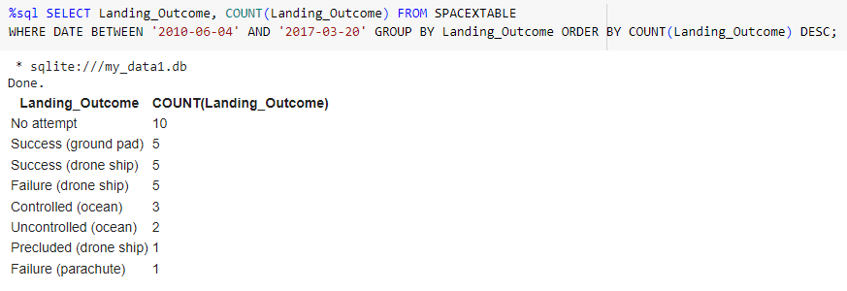
Rank Landing Outcomes Between 2010-06-04 and 2017-03-20
I selected Landing outcomes and the COUNT of landing outcomes from the data and used the WHERE clause to filter for landing outcomes BETWEEN 2010-06-04 to 2010-03-20.
I applied the GROUP BY clause to group the landing outcomes and the ORDER BY clause to order the grouped landing outcome in descending order.

Slide 34

Section 3

Slide 35

All launch sites global map markers

Slide 36

Markers showing launch sites with color labels

Slide 37

Launch Site distance to landmarks

Slide 38

Section 4

Slide 39

Pie chart showing the success percentage achieved by each launch site

Slide 40

Pie chart showing the Launch site with the highest launch success ratio

Slide 41

Scatter plot of Payload vs Launch Outcome for all sites, with different payload selected in the range slider

Slide 42

Section 5

Slide 43
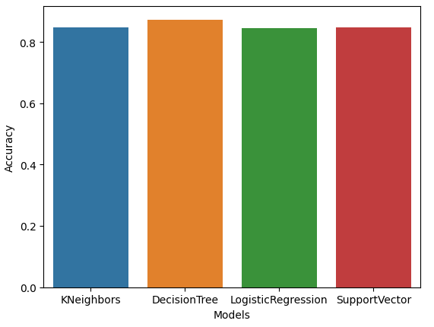
Classification Accuracy
Based on the bar chart on the left, the decision tree classifier is the model with the highest classification accuracy

Slide 44

Confusion Matrix
The confusion matrix for the decision tree classifier shows that the classifier can distinguish between the different classes. The major problem is the false positives .i.e., unsuccessful landing marked as successful landing by the classifier.

Slide 45
Conclusions
We can conclude that:
The larger the flight amount at a launch site, the greater the success rate at a launch site.
Launch success rate started to increase in 2013 till 2020.
Orbits ES-L1, GEO, HEO, SSO, VLEO had the most success rate.
KSC LC-39A had the most successful launches of any sites.
The Decision tree classifier is the best machine learning algorithm for this task.

Slide 46
Appendix
IBM-Data-Science-Capstone/Data Collection API.ipynb at main · kerygot16/IBM-Data-Science-Capstone (github.com)
IBM-Data-Science-Capstone/Data Collection With Webscraping.ipynb at main · kerygot16/IBM-Data-Science-Capstone (github.com)
IBM-Data-Science-Capstone/Data Wrangling.ipynb at main · kerygot16/IBM-Data-Science-Capstone (github.com)
IBM-Data-Science-Capstone/EDA with Data Visualization.ipynb at main · kerygot16/IBM-Data-Science-Capstone (github.com)
IBM-Data-Science-Capstone/EDA with SQL.ipynb at main · kerygot16/IBM-Data-Science-Capstone (github.com)
IBM-Data-Science-Capstone/Interactive Visual Analytics with Folium.ipynb at main · kerygot16/IBM-Data-Science-Capstone (github.com)
IBM-Data-Science-Capstone/spacex_dash_app.py at main · kerygot16/IBM-Data-Science-Capstone (github.com)
IBM-Data-Science-Capstone/Machine Learning Prediction.ipynb at main · kerygot16/IBM-Data-Science-Capstone (github.com)

Slide 47


